Slide 1
Objectives
After completing this chapter you will be able to understand:
  Types of JSP elements
  JSP scripting elements

Slide 2
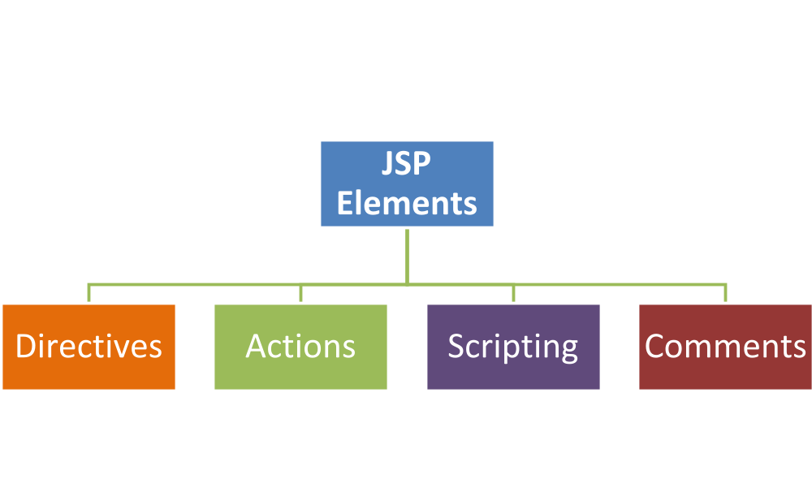
JSP Elements Types
  There are four types of elements in JSP.
In this session we will focus only on scripting element.

Slide 3
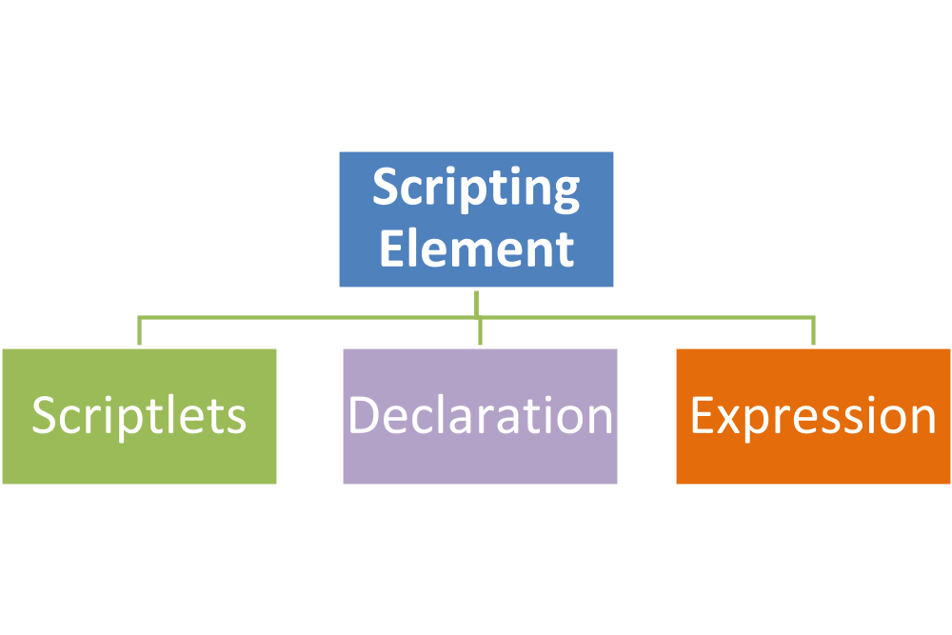
Scripting Elements
Scripting element are used to embed java code in JSP files.
There are three types of scripting elements,

Slide 4
Scriplet Element
Used to embed java code in JSP pages.
Contents of JSP scriptlet goes into _jspService() method during the translation phase.
Code should comply with syntactical and semantic construct of java.
Embedded between <% and %> delimiters.

Slide 5
How to Create a Scriplet
Scriplets are embedded between <% and %> delimiters
Syntax: <% Java code goes in here%>
Example: To print a variable value,
<%
String username = "visualbuilder" ;
out.println ( username ) ;
%>

Slide 6
Declarations Element
Declarations are used to declare, define methods & instance variables.
Declaration tag does not produce any output that is sent to client.
The methods and classes declared will be translated as class level variables and methods during translation.

Slide 7
How to Declare?
Methods or variables are declared using <%! and %> delimiters
Syntax: <%! variable= 0; %>
Example: This declares a variable count as int and set value 10.
  <%! int count= 10; %>

Slide 8
Expression Element
Used to write dynamic content back to the client browser.
Used in place of out.print() method.
Only expressions are supported inside the tag. Declarations of methods and variables is not possible inside this tag.
During translation the return type of expression goes as argument into out.print() method.
Expression should not be ended with a semicolon (;) since semicolon are automatically added during translation.

Slide 9
How to use Expressions ?
Expressions are Embedded in <%= and %> delimiters
Syntax: <%= expression 1 %>
Example: To print the date dynamically for each client request.
  <HTML>
  <BODY> Hello! The time is now <%= new java.util.Date() %>
  </BODY>
  </HTML>
The date expression will be evaluated and the current date will be printed in the HTML rendered.

Slide 10
Comments
There are two type of comments supported by JSP
HTML comment
<!-- This is a comment --!>
2. JSP Comment
<%-- This is a comment --%>
HTML comments are passed during the translation phase and hence can be viewed in the page source in the browser.
JSP comments are converted to normal java comments during the translation process and will not appear in the output page source.

Slide 11
Lend a Hand - Scriptlet elements
This is a demo to familiarize the scripting elements that are used in JSP.
We will create a JSP page called sample.jsp.
The page should calculate the number of users visiting the page and should print the value in the screen.
JSP page should use the following Scriptlets elements to
Declaration tags – for declaring methods and counter variable.
Scriptlet tag – Logic for incrementing counters.
Expression Tags – For printing the counter values.

Slide 12
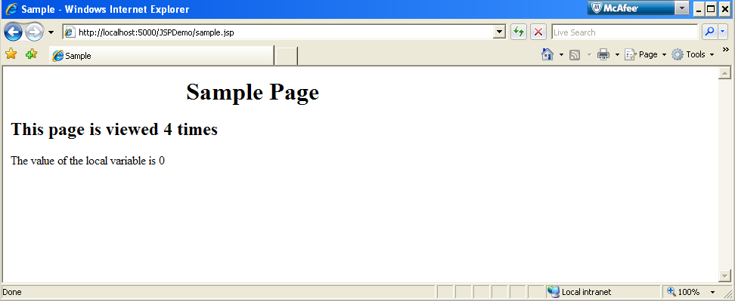
Lend a Hand- Step 1 Create sample.jsp
The page should be designed to produce the following output

Slide 13
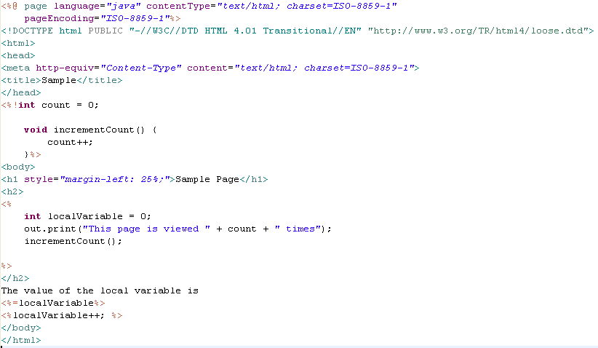
Lend a Hand- Step 1 Create sample.jsp (Cont)
Declaration Tag for declaring the count variable and the method to increment the counter.
Also define a local variable to see the difference between variables declared within scriptlet tag and declaration tag.
Scriptlets Tag for incrementing the counter.
Prints the value using Expression tag
Increments the local variable

Slide 14
Lend a Hand - Deploy and Run
Step 1 : Deploy and run the application .
Step 2 : Invoke sample.jsp from the browser
http://localhost:5000/JSPDemo/sample.jsp
NOTE: Ensure that the context root and port number are correct and based on your machine.

Slide 15
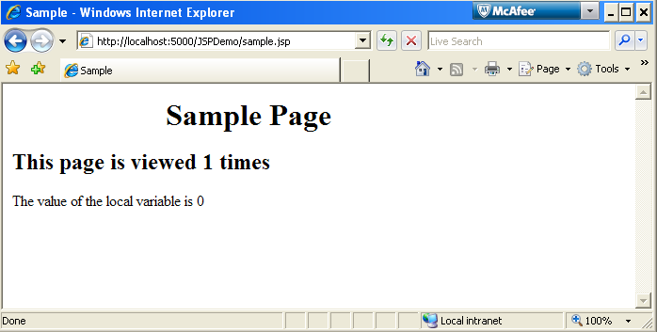
Lend a Hand - Deploy and Run (cont)
Refresh the browser and note the output
As you refresh the browser the counter increments, but the local variable will always be zero.
Inference:
Variable defined inside scriptlet are like method local variables once the method execution is complete the value stored would be lost.
Variables defined inside declaration are like class level instance variables and values will be retained across user requests.

Slide 16

Time To Reflect
Associates to quickly summarize the following before ending the session
When do you use scriptlet tag?
What is the difference between HTML & JSP comments?
What is the difference between declaring variable inside scriplet and declaration tag?
What is the use of expression tag element?

Slide 17
  Advance Java
  You have successfully completed –
  JSP Elements

